Slide 1
Principles of Web Design
Responsive Web Design

Slide 2
Objectives
Recognize the need for responsive web design
Use media queries to apply conditional styles
Build a basic media query
Create flexible responsive layouts
Create responsive navigation schemes
Use responsive images
Build a responsive web page design for desktops, tablets, and smartphones

Slide 3
Recognizing the Need for Responsive Web Design

Slide 4
Recognizing the Need for Responsive Web Design
Tablets and smartphones add to web design challenge
More device sizes, screen orientations, and screen resolutions
Design responsively rather than for specific devices

Slide 5
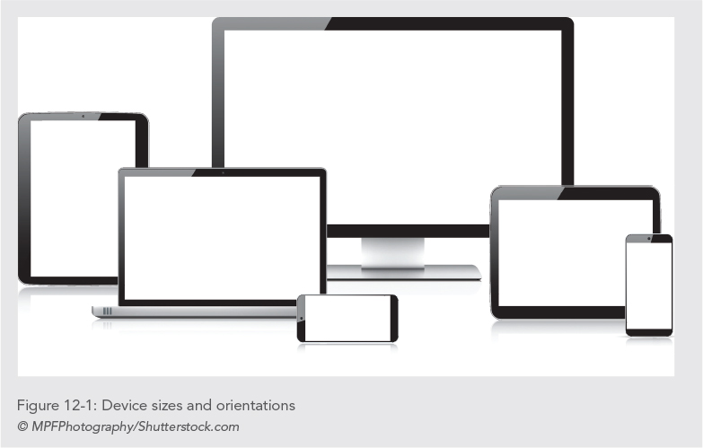

Slide 6
Recognizing the Need for Responsive Web Design
Traditional web design techniques do not adapt well to mobile devices
Legibility and navigation are challenges
Responsive design lets you build a more flexible type of web page that responds to the varying size of mobile displays

Slide 7
Recognizing the Need for Responsive Web Design
Three main elements of responsive design:
CSS media queries - Using these expressions, you can apply styles based on display device characteristics
Flexible images - These images adapt to the parameters of the user’s screen size
Flexible layouts - These layouts realign elements of your content structure based on the display device

Slide 8
Recognizing the Need for Responsive Web Design
Figure 12-2 shows the responsive design of the World Wildlife Fund web site at five screen resolutions
Both page designs are flexible to adapt to sizes above or below the 768-pixel threshold
This threshold is called the breakpoint—the point at which design layouts change in responsive design schemes

Slide 9
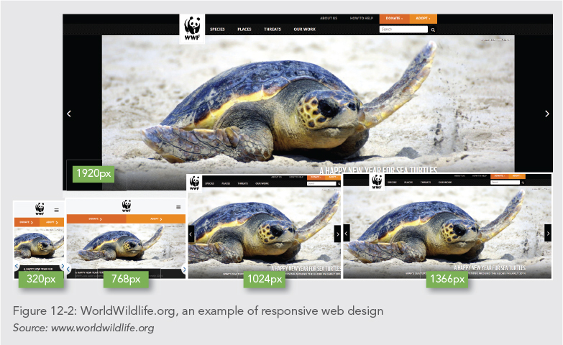

Slide 10
Recognizing the Need for Responsive Web Design
Use CSS style rules to change the order, positioning, and other display characteristics of your page elements
Build one basic layout and then use style rules targeted to different screen sizes

Slide 11
Recognizing the Need for Responsive Web Design
Figure 12-3 shows the range of sizes and the breakpoint used in the style of the World Wildlife site
The web site design adapts to larger screen sizes, expanding and adding more content and navigation as the browser widths increase
In this example, the breakpoint is set to 768 pixels

Slide 12
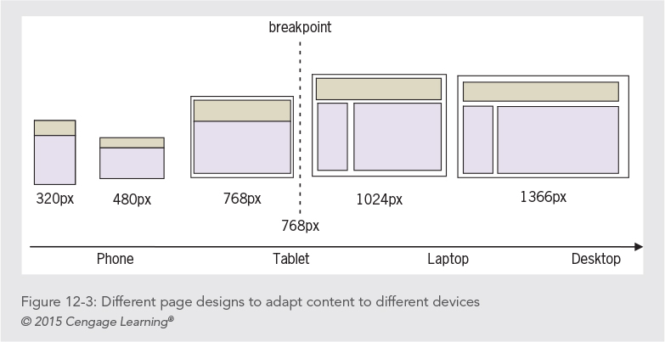

Slide 13
Recognizing the Need for Responsive Web Design
Choose a breakpoint and then design for the devices above and below that point
1
Adapt your design for optimal viewing in each range of screen sizes
2
Content, not the device needs, should dictate when you choose breakpoints
3

Slide 14
Recognizing the Need for Responsive Web Design
You can control style characteristics including:
Adding and removing entire columns
Changing navigation
Stacking columns on top of each other

Slide 15
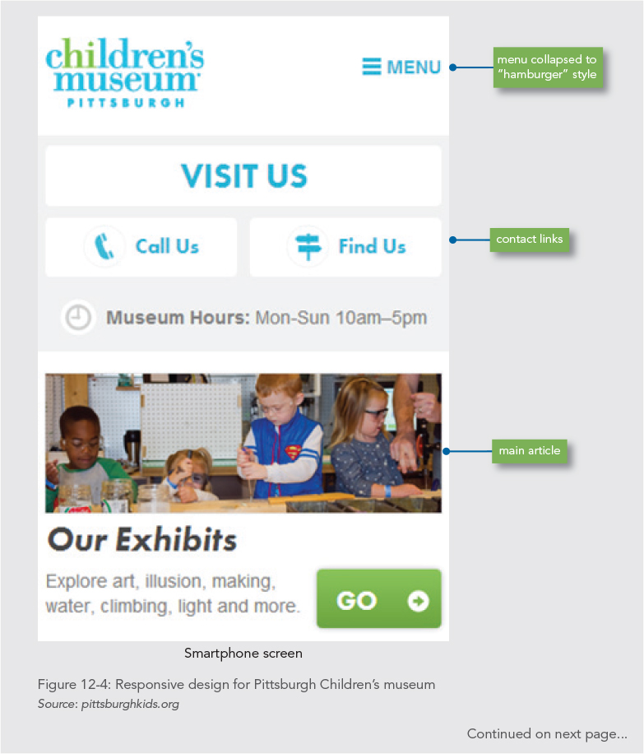

Slide 16
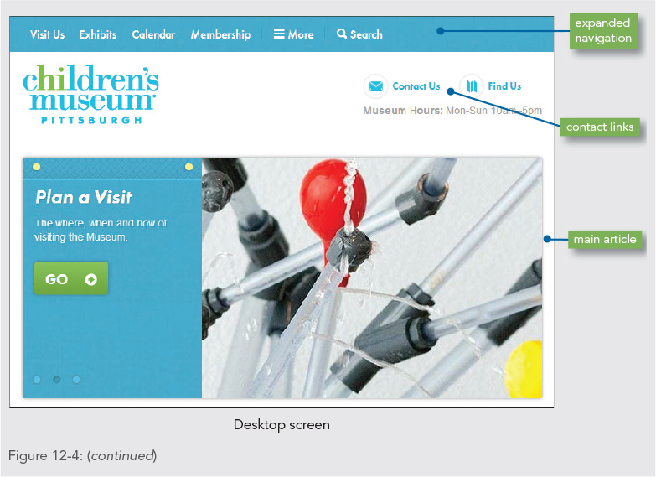

Slide 17
Content-First Design
Think carefully about your content and users’ needs when building responsive designs
Which content is valuable to the user of a smaller device?
How much content can be used effectively on each device?
Will you have to edit or restructure content?

Slide 18
Measurement Units in Responsive Design
Breakpoints are best measured in ems
Ems are better than pixels because they are flexible
It is easier to design in pixels, so convert pixels to ems
1 em equals 16 px

Slide 19
Using Media Queries to Apply Conditional Styles

Slide 20
Using Media Queries to Apply Conditional Styles
Media queries let you create precise rules for destination media.
A media query contains both a media type and optional expressions that check conditions called media features
Media features include variables such as the width or height of the destination device

Slide 21
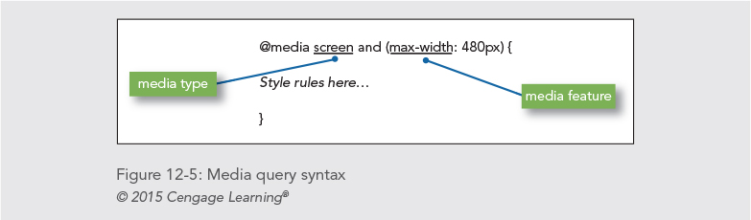
Using Media Queries to Apply Conditional Styles
Figure 12-5:
The media type is screen and the media feature is max-width. The max-width value is 480 pixels.

Slide 22
Using Media Queries to Apply Conditional Styles
With the addition of the following style rule, the browser will detect the maximum width of the screen. If it is 480 pixels or less, the header element will have a width of 90%.
@media screen and (max-width: 480px) {
header {width: 90%;}
}

Slide 23
Using Media Queries to Apply Conditional Styles
You can add multiple media features with the and keyword
@media screen and (min-width: 480px) and (max-width: 768px)

Slide 24
Applying Media Queries
You have three options for applying media queries to specify style rules
In the following three examples, the styles are applied if the device screen has a maximum width of 480 pixels

Slide 25
Applying Media Queries
In the first example, the link element applies an external style sheet named mobiledevice.css if the device screen has a maximum width of 480 pixels:
<link rel="stylesheet" media="screen and (max-width: 480px)” href="mobiledevice.css">

Slide 26
Applying Media Queries
The second example uses an @import rule to apply an external style sheet named mobiledevice.css if the device has a screen with a maximum width of 480 pixels:
@import url("mobiledevice.css") screen and (max-width: 480px);

Slide 27
Applying Media Queries
The third example uses the @media rule within a <style> element:
<style>
@media screen and (max-width: 480px) {
style rules here
}
</style>

Slide 28
Multiple Style Rules for Three Breakpoints
/* smaller than 1024 pixels */
@media screen and (max-width: 1024px) {
style rules here
}
/* smaller than 768 pixels */
@media screen and (max-width: 768px) {
style rules here
}
/* smaller than 480 pixels */
@media screen and (max-width: 480px) {
style rules here
}

Slide 29
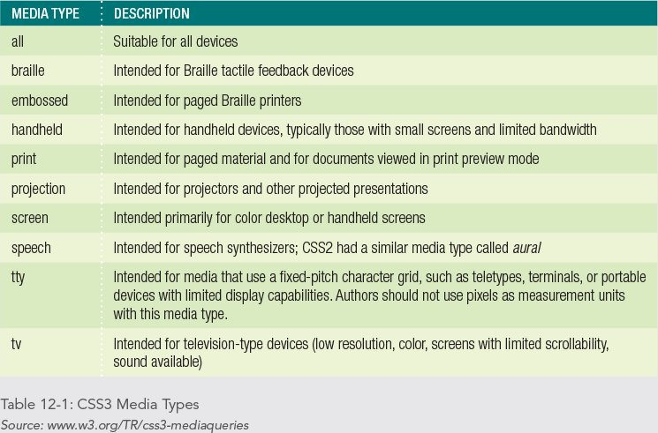
Media Types

Slide 30
Setting the Viewport Scale
The viewport is equal to the size of the browser window
The viewport on handheld devices is much narrower than a desktop browser window
The narrower viewport causes problems with responsive web pages.
Include this meta tag to set the viewport:
<meta name="viewport" content="width=device-width, initial-scale=1.0">

Slide 31
Creating Flexible Responsive Layouts

Slide 32
Creating Flexible Responsive Layouts
Combine flexible layout techniques with media queries to extend the use of flexible layouts to adapt to any device size
In the following example, the flexible layout works well over 750 pixels wide
Under 750 pixels, the user must scroll horizontally

Slide 33
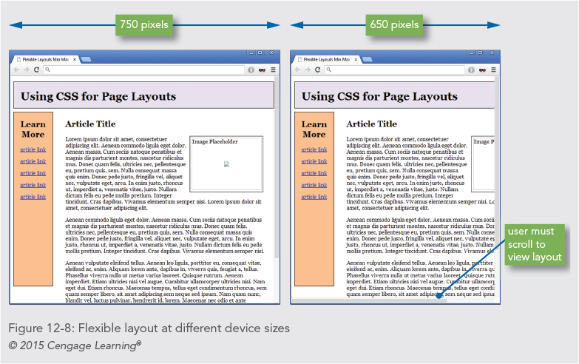

Slide 34
Creating Flexible Responsive Layouts
To solve this problem, the layout’s flexibility must be extended to include all screen sizes from smartphones to desktop displays, as shown in Figure 12-9

Slide 35
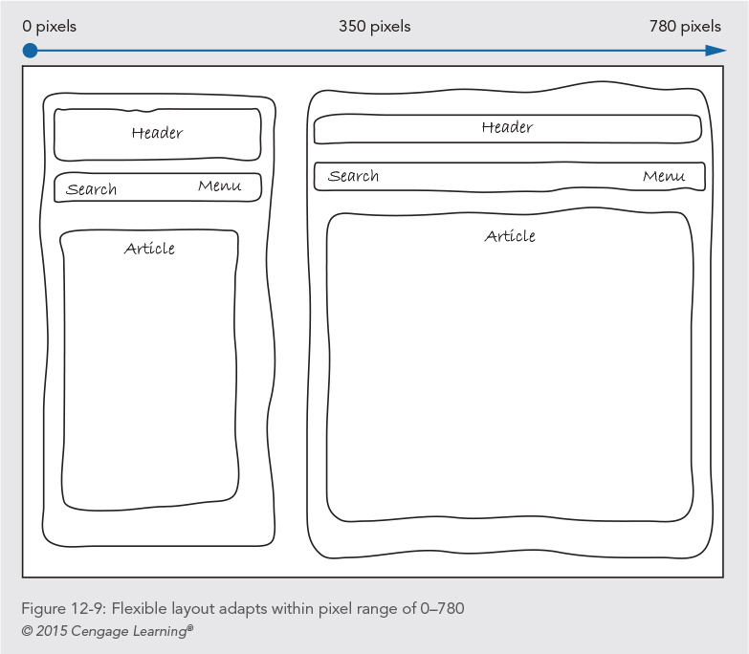

Slide 36
Creating Flexible Responsive Layouts
This proposed layout works well at any width between the smallest device and 780 pixels
Once the design is expanded past 780 pixels, the content is spread too widely across the page
The page design can change to take advantage of the larger screen size

Slide 37
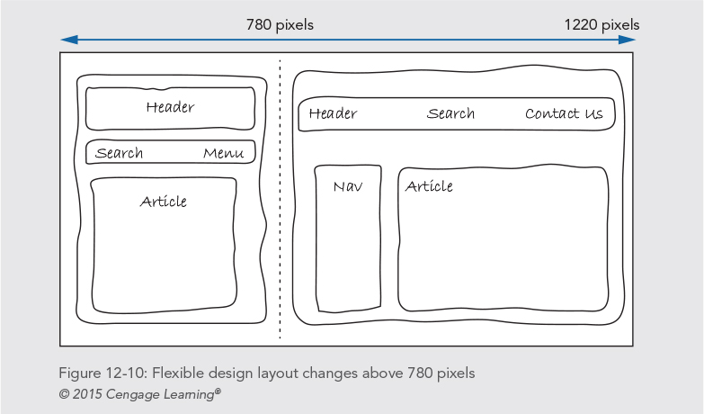

Slide 38
Creating Flexible Responsive Layouts
The mockup in Figure 12-11 shows how the page design can adapt to different sizes within the ranges specified by the media queries

Slide 39
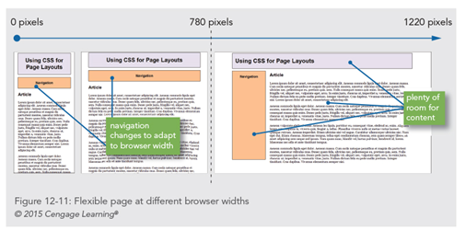

Slide 40
Creating Flexible Responsive Layouts
The display property can be used to remove or add content as needed
Figure 12-14 shows an example of hiding or displaying content based on the browser width
The larger page design takes advantage of expanded screen space, while the smaller mobile design focuses on user navigation and content access

Slide 41
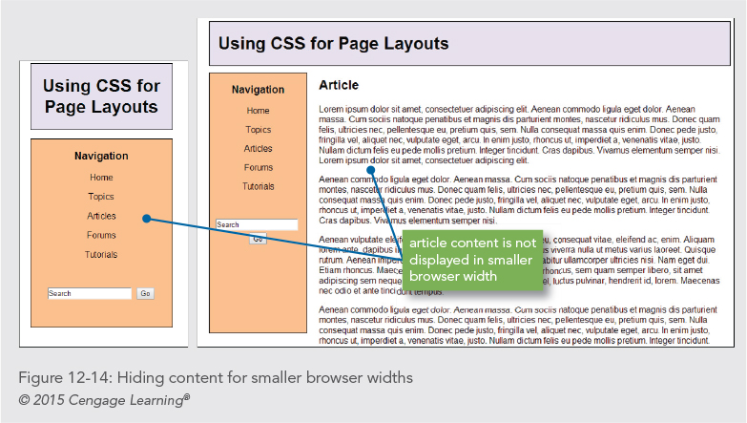

Slide 42
Creating Responsive Navigation Screens

Slide 43
Creating Responsive Navigation Screens
When readers access on a smartphone, they have different navigation motives than when using a larger screen
Mobile sites should offer the most popular links readily available on the first page
Navigating on a small device is much easier when the navigation is direct and accessible

Slide 44
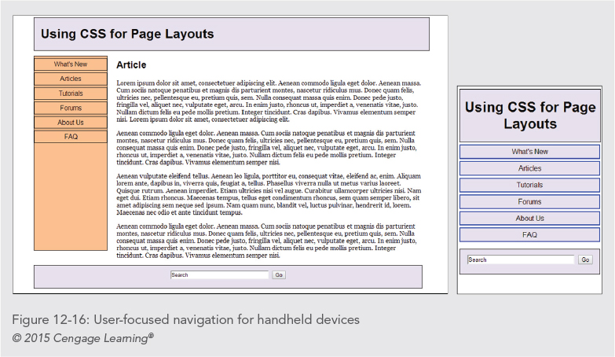

Slide 45
Using Responsive Images

Slide 46
Using Responsive Images
When building responsive layouts, consider the behavior of images and how they react to different device sizes
You can let images adjust to the browser size or have a fixed size

Slide 47
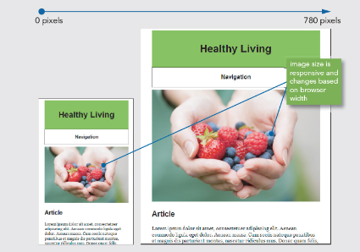
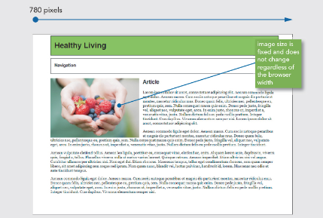
Using Responsive Images
Flexible
Fixed

Slide 48
Using Responsive Images
Set the image’s height to auto to maintain the aspect ratio when the image is scaled:
img {
max-width: 100%;
height: auto;
}

Slide 49
Using Responsive Images
With a style rule, you can choose to set a minimum fixed width for the image if necessary:
img {
min-width: 240px;
}

Slide 50
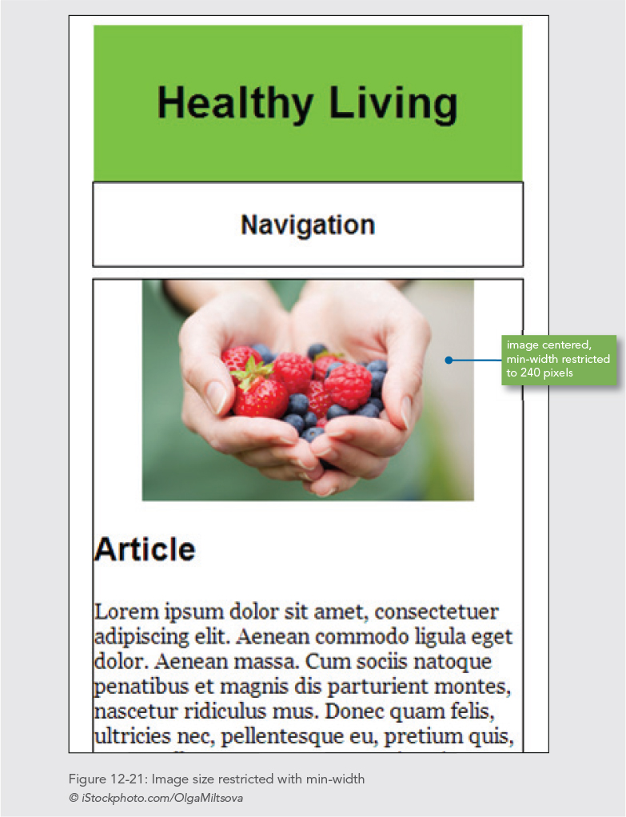

Slide 51
Using Responsive Images
You can wrap text around an image in a responsive column
Float the image and set a width for the image that is a percentage of the containing column
The image style rule sets the width at 40%, down to a minimum width of 200 pixels

Slide 52
Using Responsive Images
The image style rule sets the width at 40%, down to a minimum width of 200 pixels:
img {
float: left;
width: 40%;
height: auto;
min-width: 200px;
margin: 0 1em 1em 0;
}

Slide 53
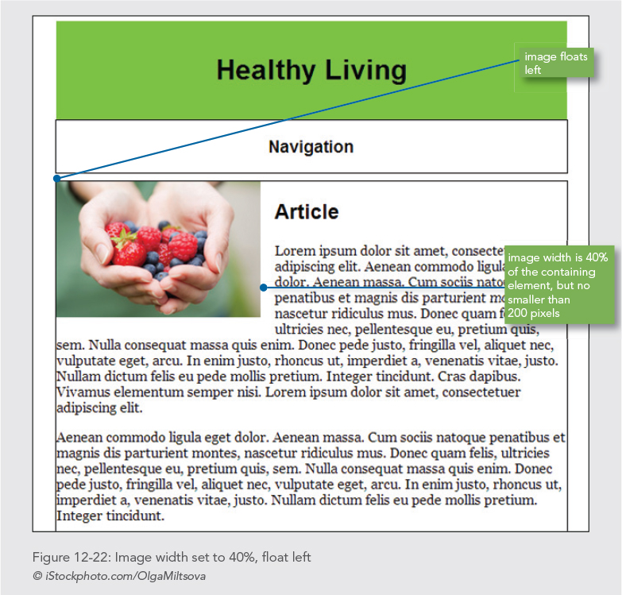

Slide 54
Chapter Activity: Building a Responsive Design

Slide 55
Activity Objectives
Adapt a typical web page design to a responsive web design
Determine breakpoints in the content
Determine the best responsive content layouts
Use media queries to build a set of style rules for the two content breakpoints

Slide 56
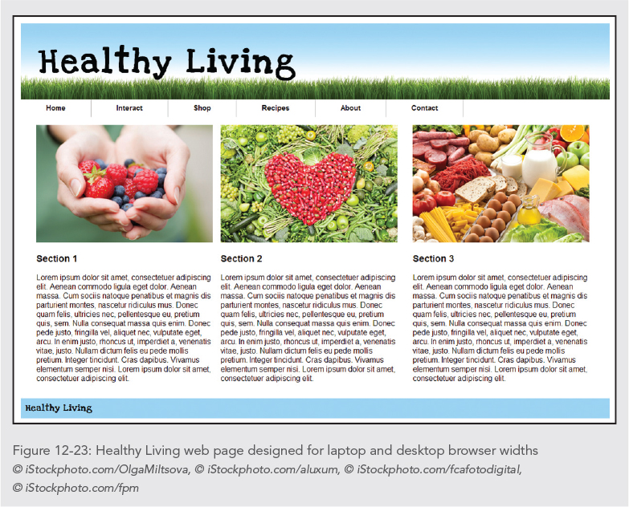

Slide 57
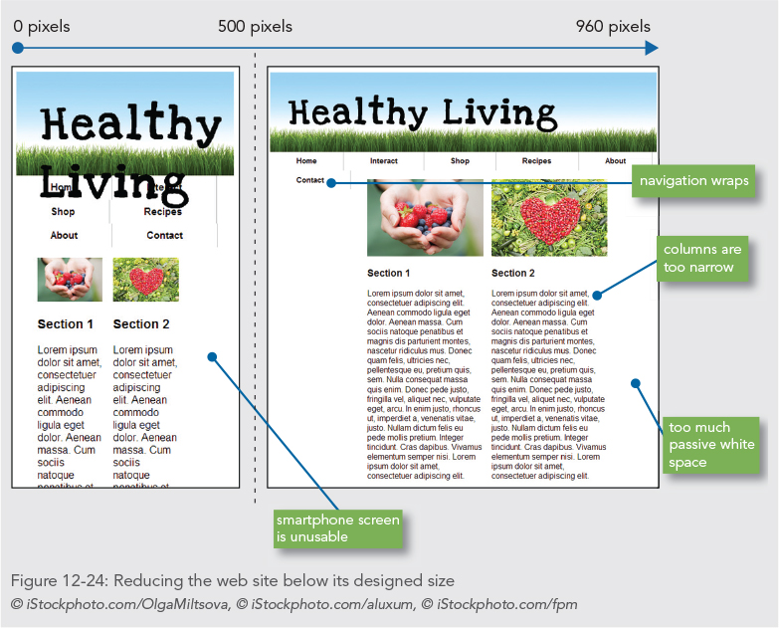

Slide 58
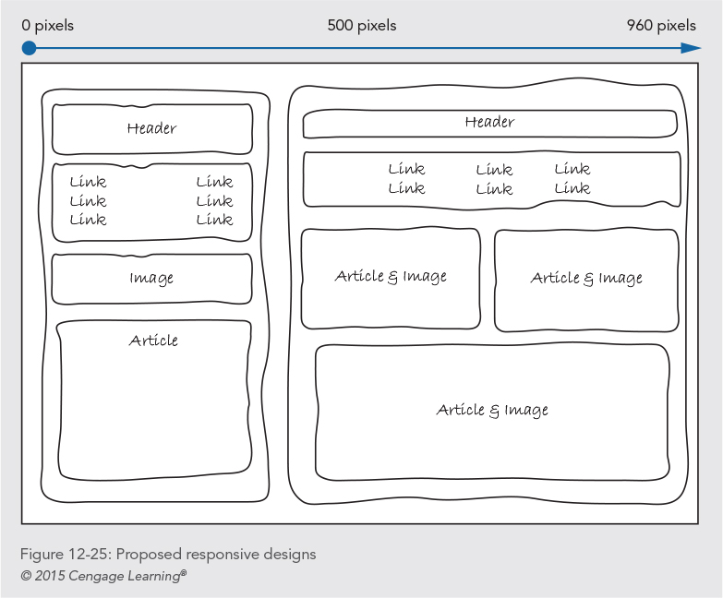

Slide 59
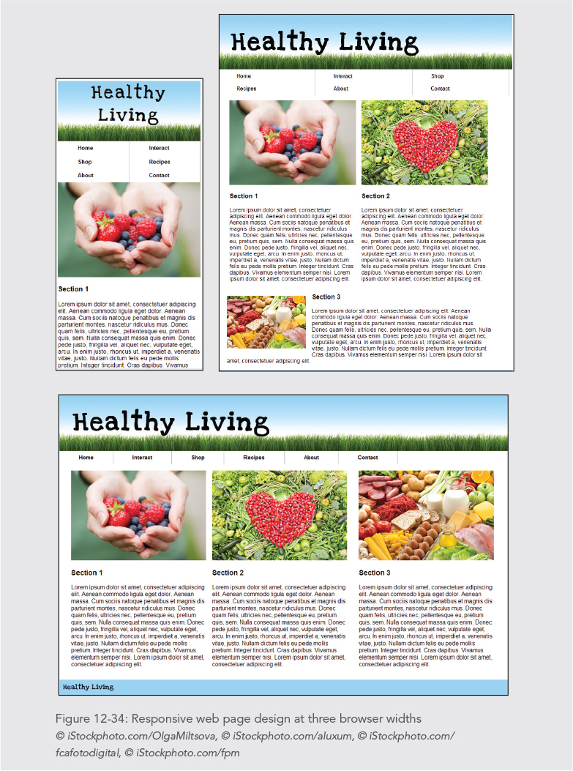

Slide 60
Summary
Media queries let you apply conditional styles based on different device properties
Responsive web page designs let you create one source of content and use style sheets and media queries to adapt the page design to different devices
Design for the needs of the content, not the device
Remove or add content as necessary to provide the best experience for the user
Use the fewest breakpoints possible, and determine the breakpoints by examining how the content behaves at different browser widths

